Slide 1

Vendor Project
Bug Smashers collaboration.
Chad Galloway,
Dennis Witt,
Richard Boyd.

Slide 2
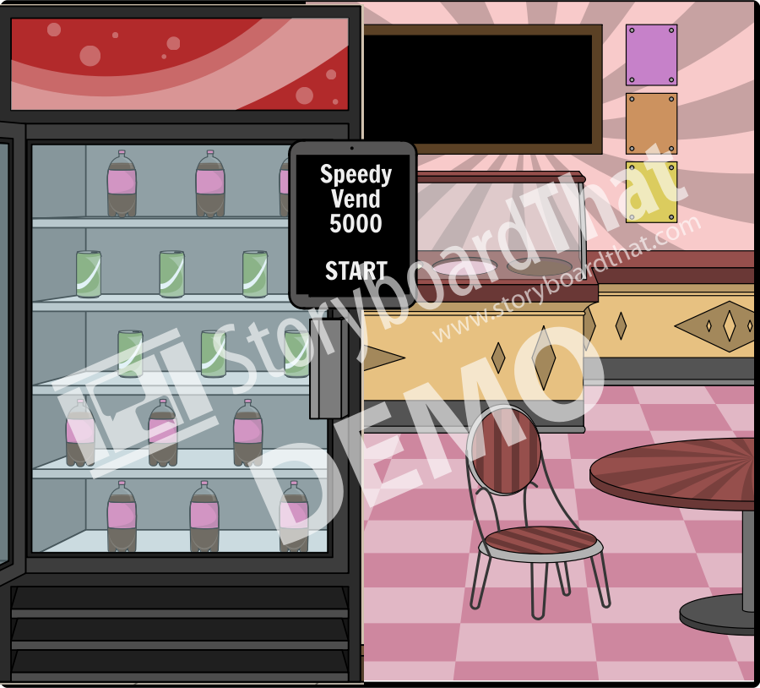
Speedy Vend 5000
Touch screen interface integrated into a standard vending machined mechanism.

Slide 3
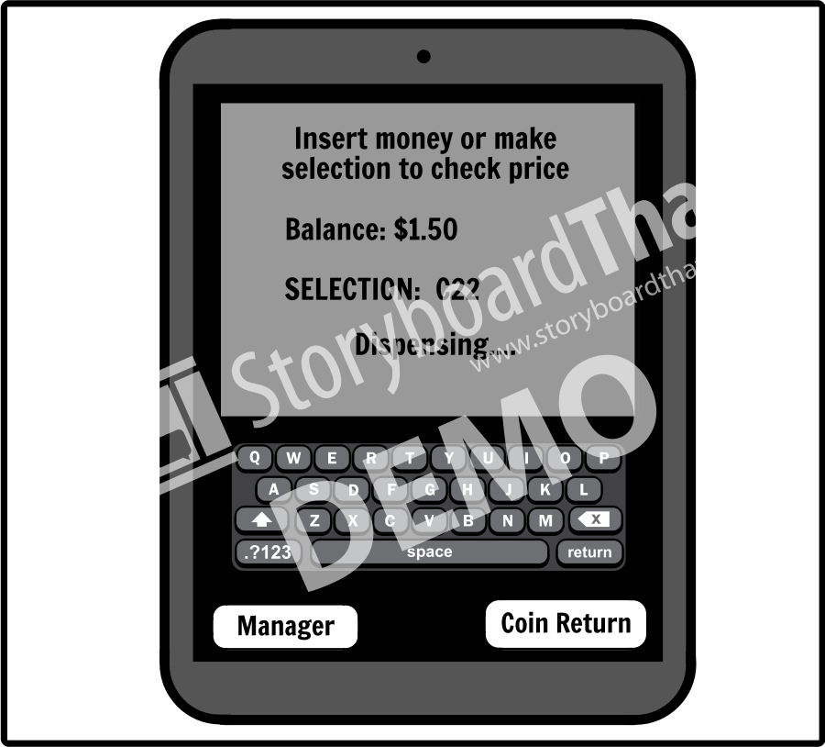
Customer Interface
Functions very similarly to standard machines.
Customer can add money and make selections on the keyboard.
Manager access granted from this screen.

Slide 4
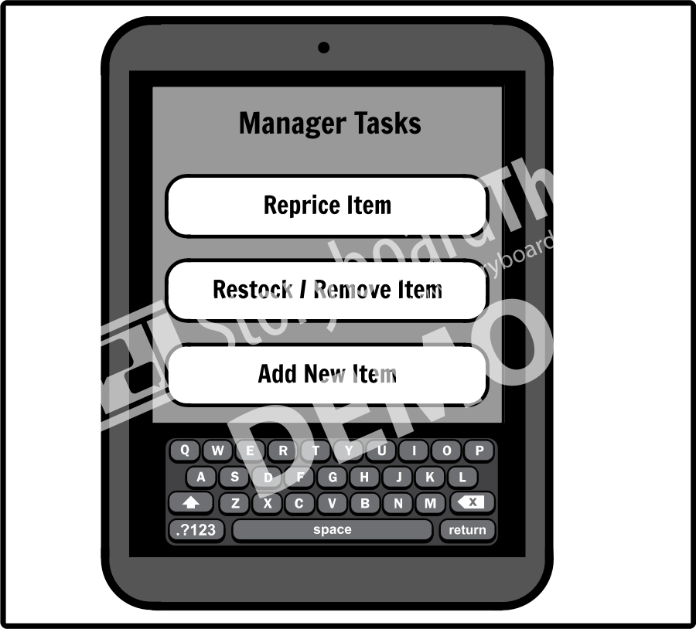
Manager Interface
After a brief login page the manager will land here.
Options:
Change the price of an item.
Change the number of items in any given location (Restock / Remove).
Add a completely new Item

Slide 5
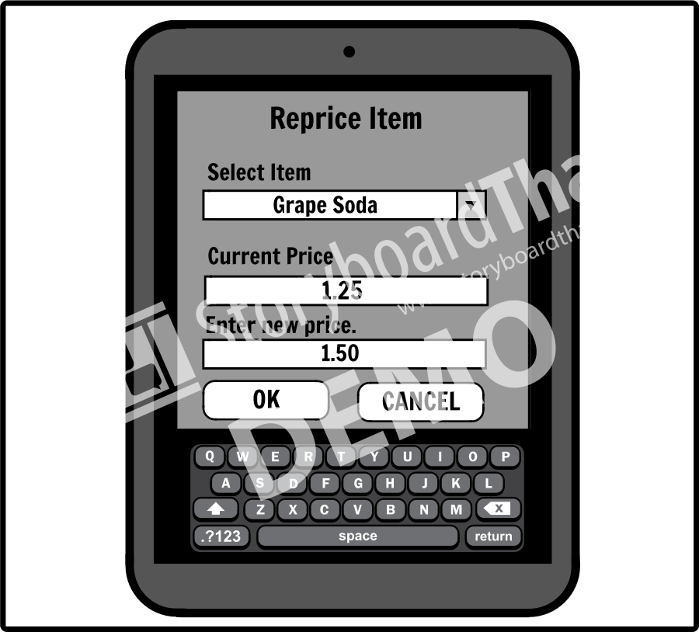
Reprice Item
Select desired item from drop down list.
Displays current price.
Allows the manager to enter a new price.

Slide 6
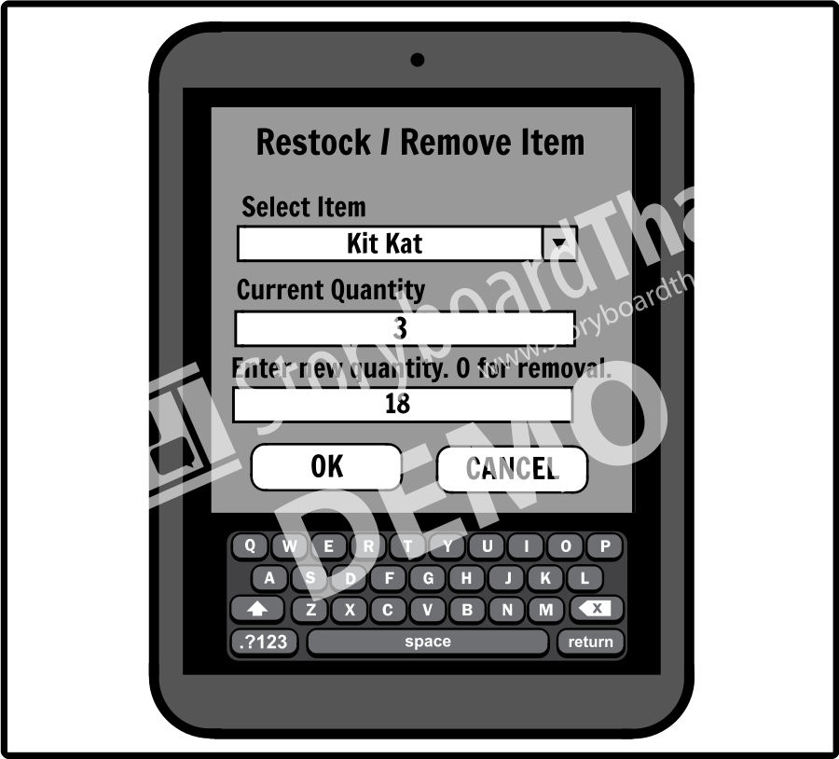
Remove / Restock Item
Select desired item from a drop down list.
Displays current quantity on hand.
Allows manager to enter a new quantity or enter zero to remove the item from the machine.

Slide 7
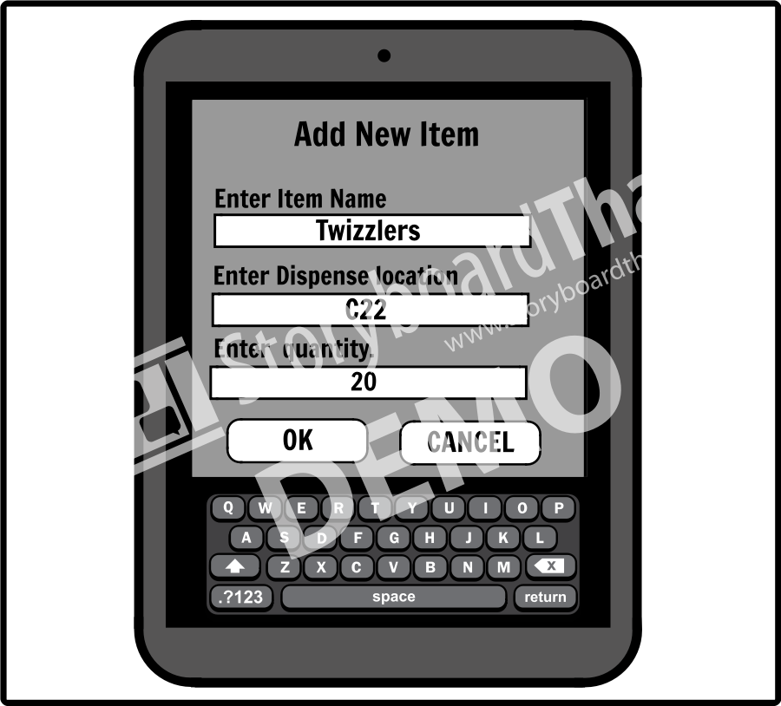
Add New Item
Manager enters a unique name for the item.
Manager selects the location where the item will be dispensed from.
Manager enters the new quantity.

